Slide 1

Cyclistic case study Google Analytics
BY: Manikant sharma

Slide 2
About Company:
Cyclistic, a bike-share company in Chicago started in 2016. since then the program has grown to a FLeet of 5,824 bicycles that are geo-tracked and locked into a network of 692 stations across Chicago. The bikes can be unlocked from one station and returned to any other station in the system anytime.
Lily Moreno: The director of marketing. Moreno is responsible for the development of campaigns and initiatives to promote the bike-share program. These may include email, social media, and other channel.
Moreno’s goal: Design marketing strategies aimed at converting casual riders into annual members.

Slide 3
Agenda: How to increase Bike Rental Subscribers
Reason: The Memberships are proven to be more profitable than the daily rides.
Analysis Focus: How the casuals and members rides the bike differently.
Goal: To increase the number of subscribers

Slide 4
Casuals and members
CASUAL RIDES:
Full Day Pass
Single Ride Pass
MEMBERSHIPS:
Annual Subscribers

Slide 5
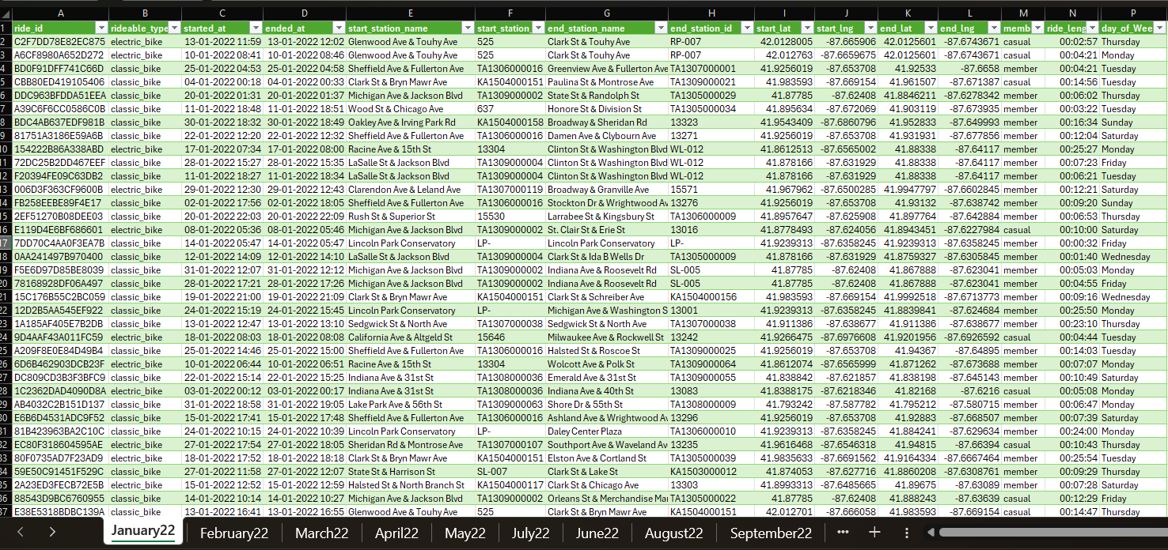
ORIGINAL DATA: BIKE RIDES FROM JANURARY 2022 TO DECEMBER 2022

Slide 6

Data cleaning
Data had more than 5 Millions rows
Used power query to Transform data
Removed unwanted columns
Checked for errors
Calculated ride length (end_time-Start_time)
INSERTED MONTH, DAY, TIME, RIDE DURATION

Slide 7
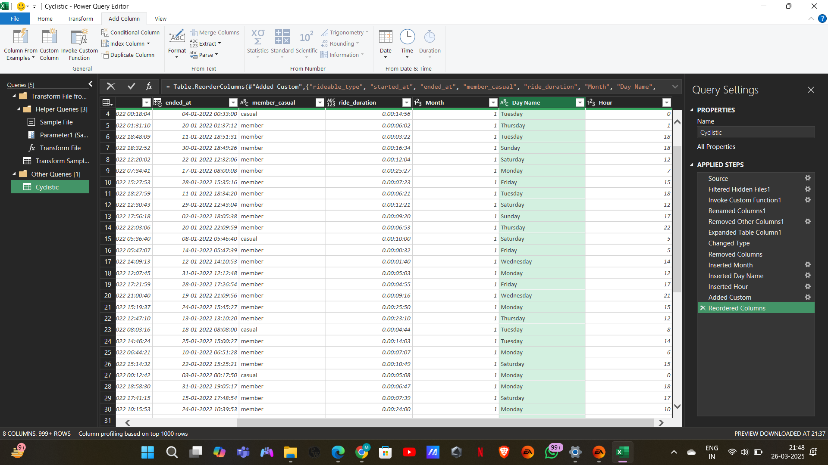
POWER QUERY FOR DATA TRANSFORMATION

Slide 8
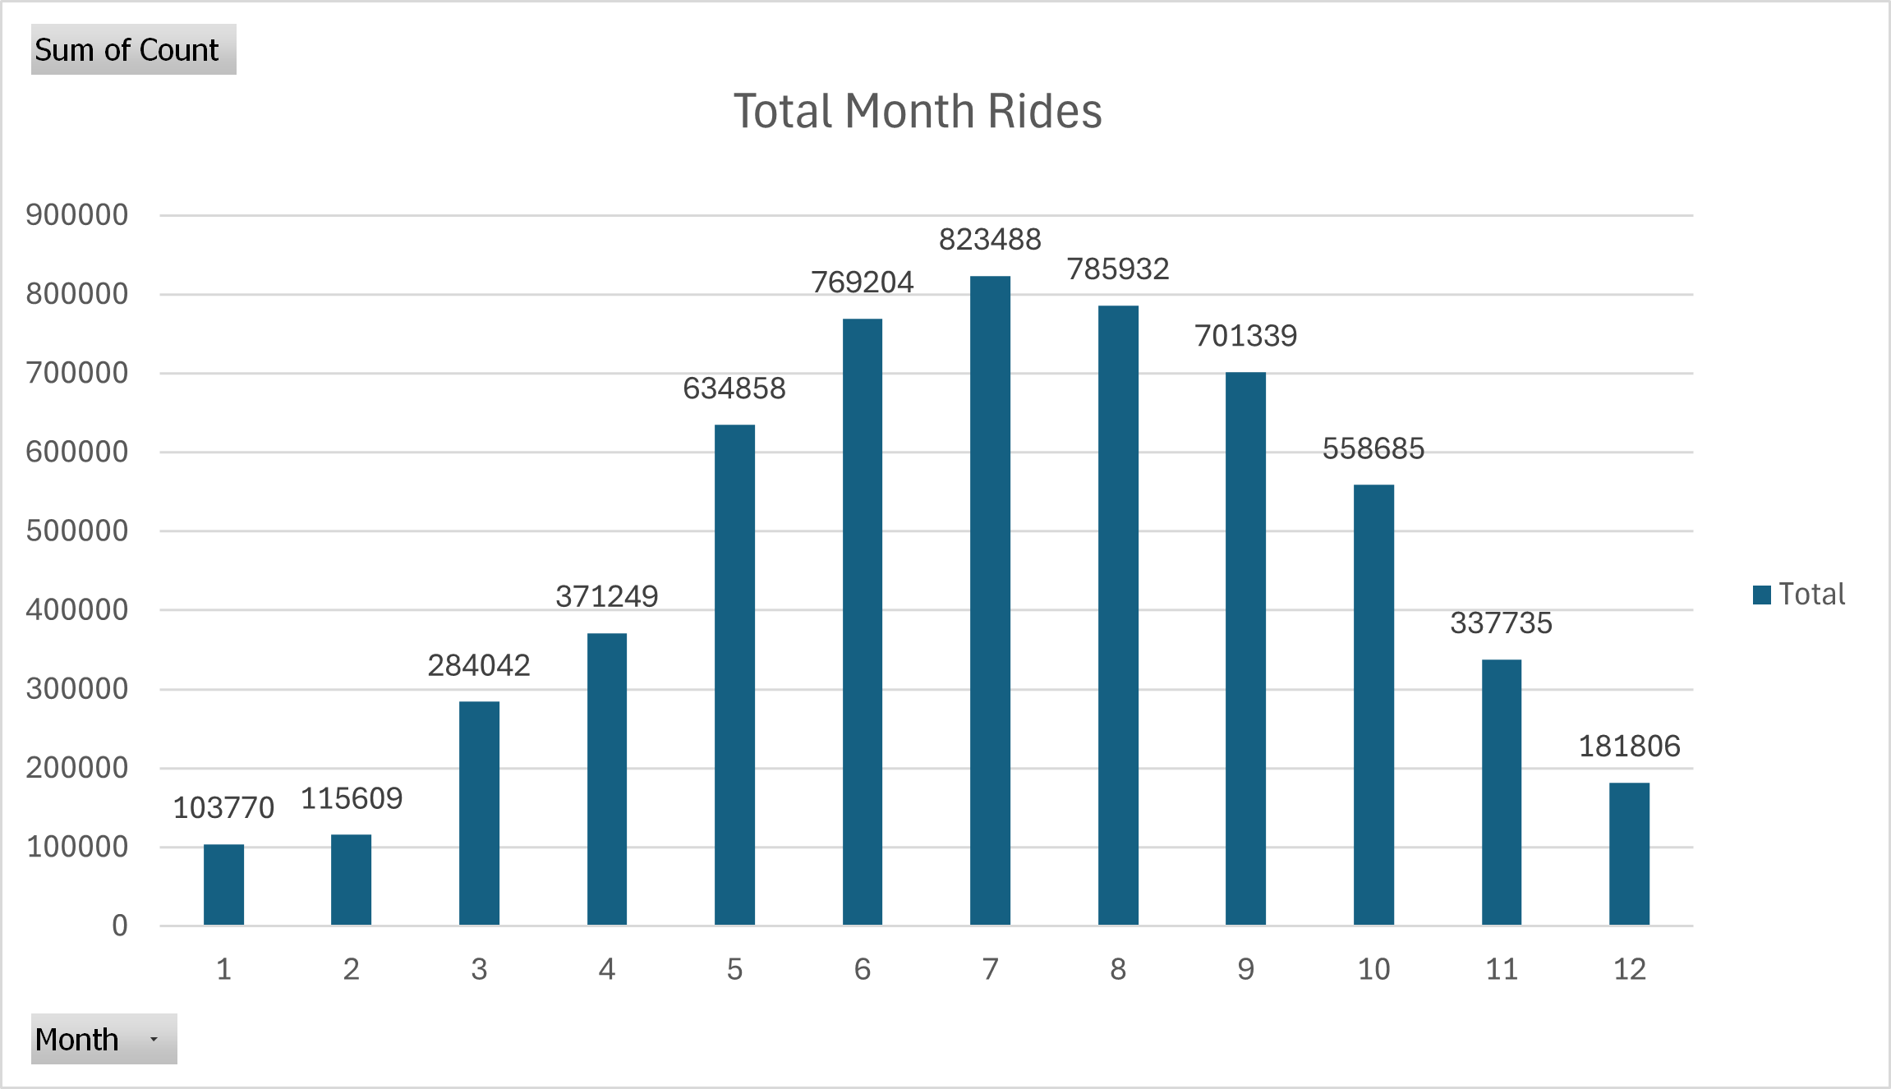
USING PIVIOT CHART FOR VISUALIZATION
THIS VISUALIZATION SHOWS YEAR LONG RIDES
Most rides in July
Least rides in January
As the weather warms up the rides increase

Slide 9
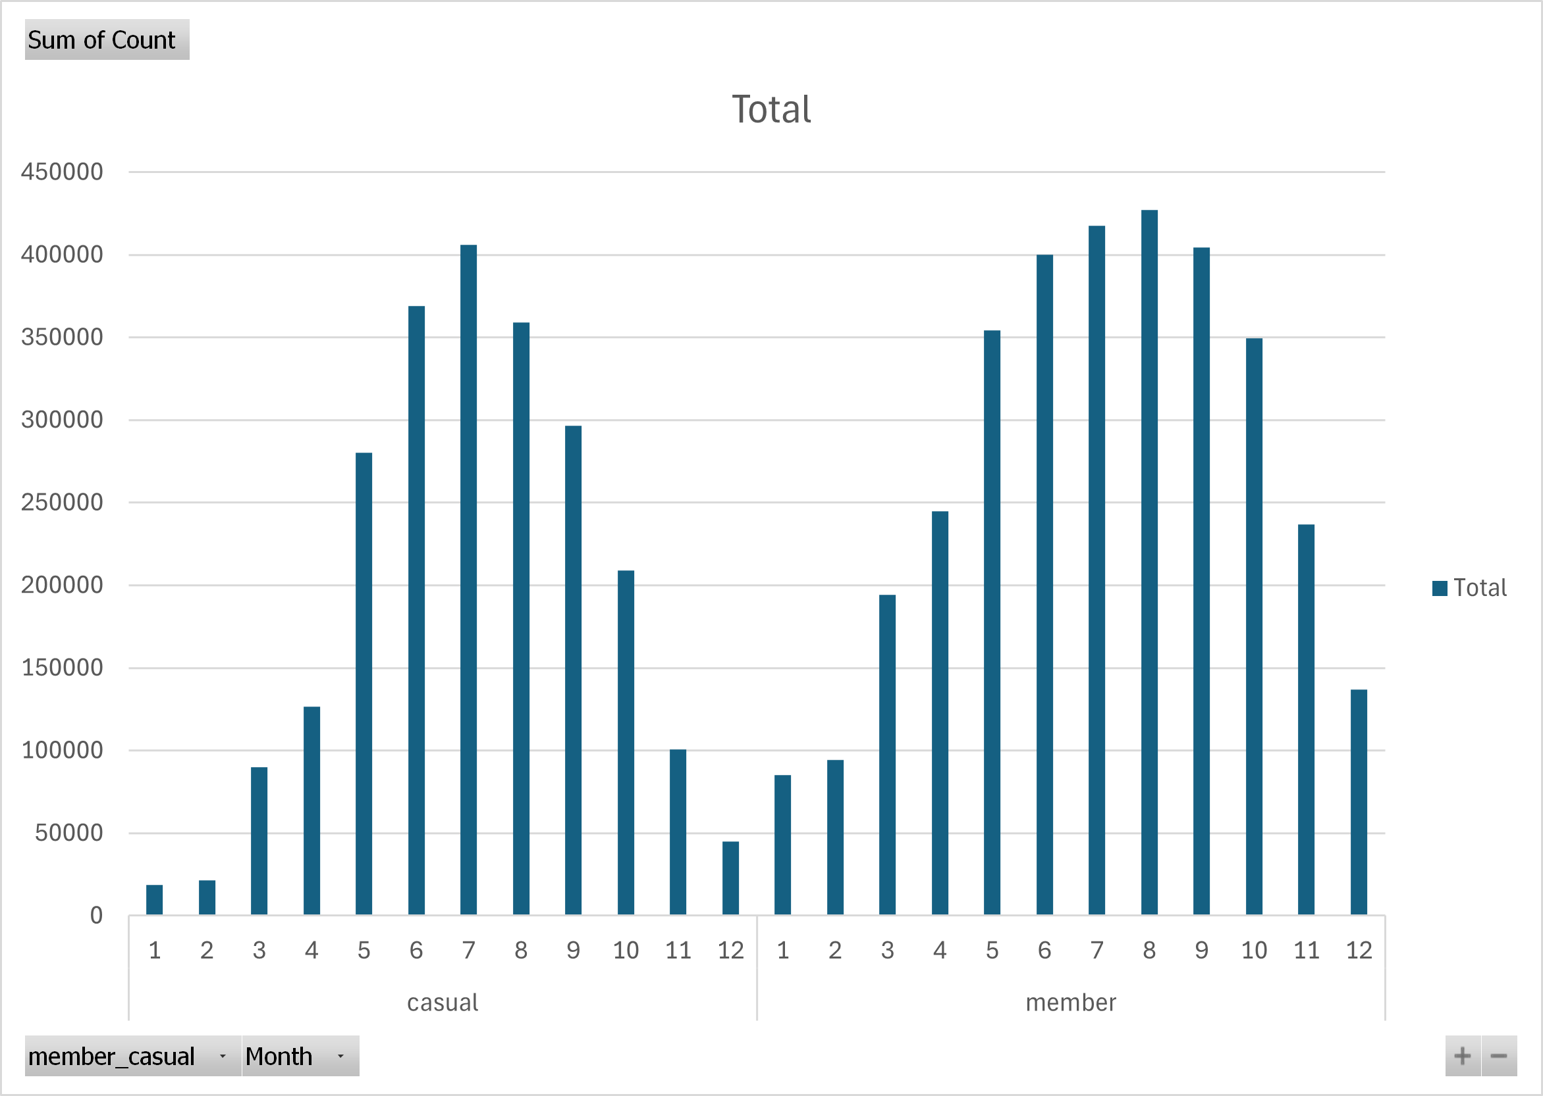
Do casuals & members ride differently ?
Member ridership is consistently higher, especially during the winter months.
Both casual riders and member riders exhibit similar riding patterns throughout the year.
Members are more likely to ride in winter as they have paid for an annual subscription.
The desire to maximize the value of their membership likely encourages them to ride even in colder weather.

Slide 10
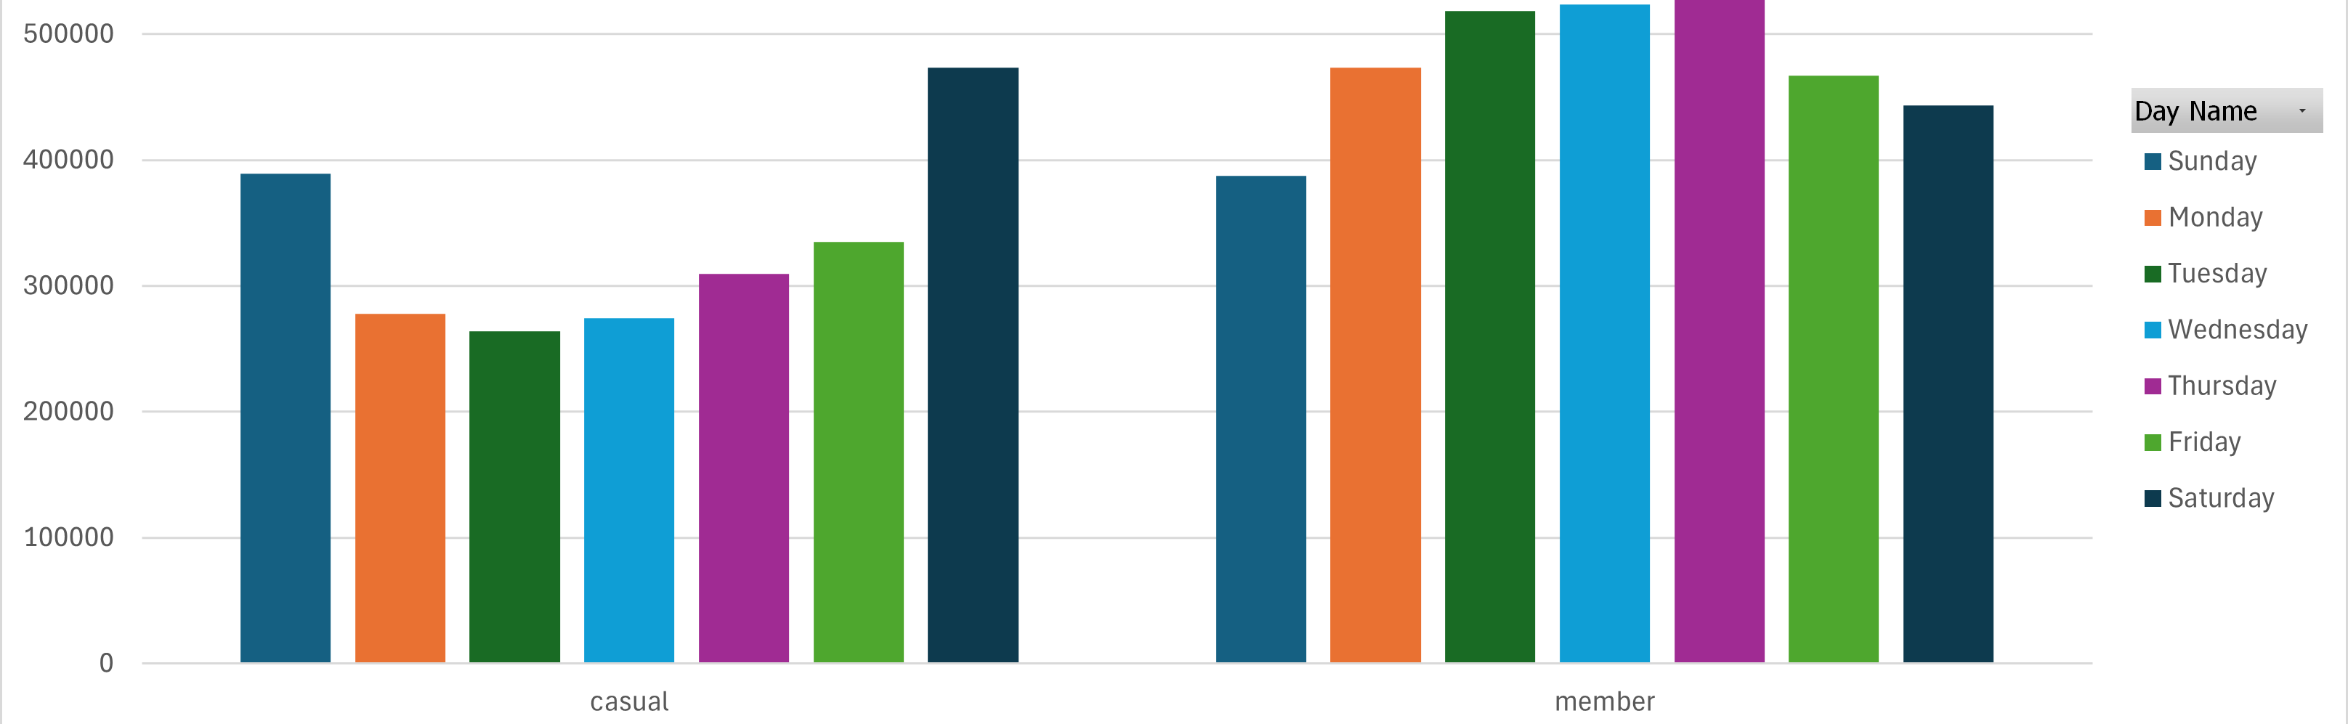
Weekly pattern
There’s a clear difference !
Casuals rides the most at weekends
Members rides the most during weekdays

Slide 11
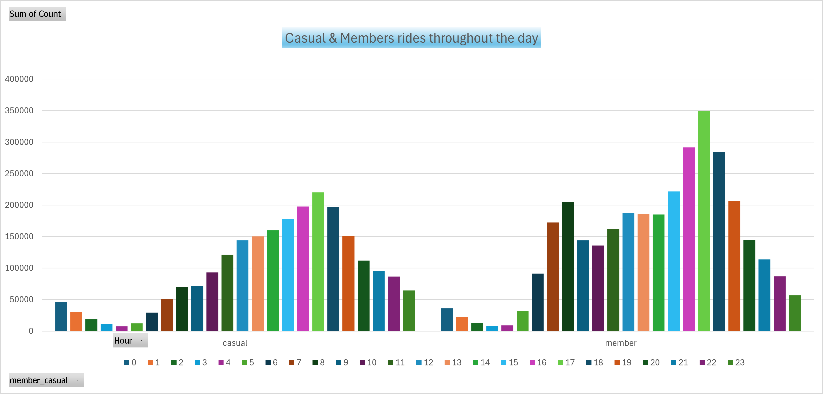
Rides during the day
The only difference we see is members riding more during morning.
By this visual we can confirm the fact that most members are using the bike for commuting to and from the office.

Slide 12
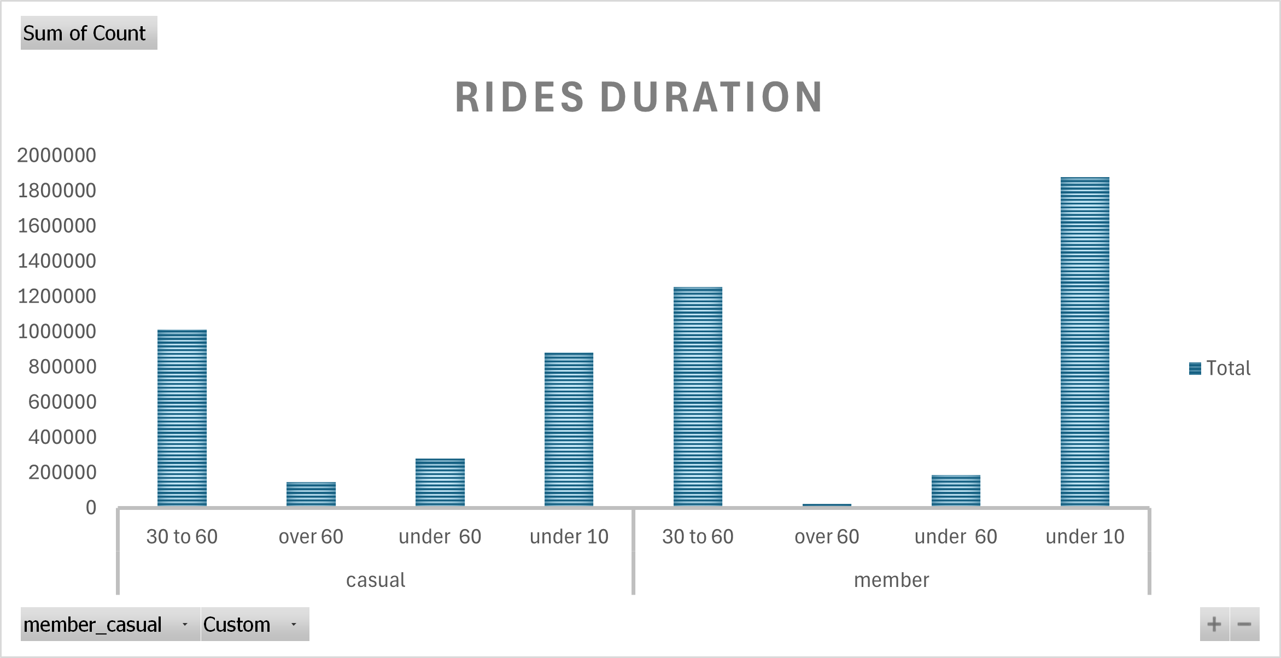
RIDING Durations
WHAT DOES THIS VISUAL TELL ?
Members opt more for a quick ride.
Casuals ride longer as they pay per ride, they seek to maximize value.

Slide 13
What does this data say ?
Most rides in summers
Members use the service most during the weekdays
Casuals rides the most on weekends
Maximum rides takes place during the office commute timings (9-11)AM & (4-6)PM
Members opt for a shorter ride while casuals tends to ride longer

Slide 14
How to increase Subscribers ?
TARGETING OFFICE PROFESSIONALS
INTRODUCING A WEEKEND PACKAGE
MARKETING RIGHT BEFORE SUMMERS
We’ve noticed that many members are using the service for their office commute. It would be more effective to tailor our marketing towards office professionals.
Since most casuals riders prefer weekends while members ride less, many bikes remain available at docking stations. Introducing a weekend package targeted at casual riders could be an effective solution
Since biking is more popular in Chicago during the summer, a well-timed marketing campaign before the season or strategic winter discounts could help attract more subscribers and maximize engagement.

Slide 15
Thank you
Manikant sharma | Sharma.manikant05@gmail.com |

